Slide 1
Software Design & Architecture Lecture 2
SESD-2222
Fall 2024
M Khizar Hayat
Khizer.hayat@ucp.edu.pk
Office: Building D, 2nd floor
OFFICE HOURS: Tuesday : 02:00 PM- 04:00 PM
Friday: 11:00 AM- 01:00 PM

Slide 2
Today’s Agenda
Design Model
Design Goals
Conceptual Design
Technical Design

Slide 3
Design Model
Components of a design model :
Data Design
Transforms information domain model into data structures required to implement software
Architectural Design
Defines relationship among the major structural elements of a software
Interface Design
Describes how the software communicates with systems that interact with it and with humans.
Procedural Design
Transforms structural elements of the architecture into a procedural description of software components
Software Design
An iterative process transforming requirements into a “blueprint” for constructing the software.

Slide 4
Goals of the Design Process
The design must implement all of the explicit requirements contained in the analysis model and it must accommodate all of the implicit requirements desired by the customer.
The design must be a readable, understandable guide for those who generate code and for those who test and subsequently support the software.
The design should address the data, functional and behavioral domains from an implementation perspective

Slide 5
Translating Analysis Model into a Software Design

Slide 6
Design
The purpose of design is to produce a solution to a problem:
The problem: requirements specification.
The solution: your description of how the requirements are to be met.
Design is the creative process of describing and transforming a problem into a solution.
A set of documents on whose basis a software can be fully programmed.

Slide 7
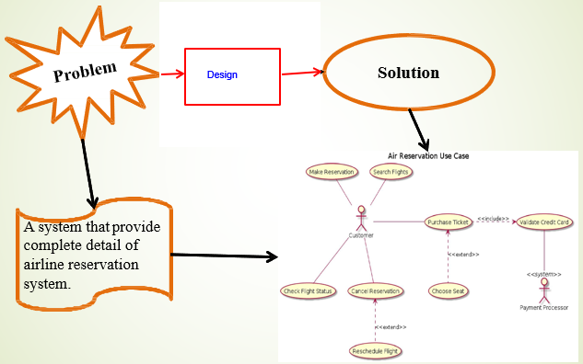
Design (contd..)

Slide 8
Software Design
Software design describe:
All the parts of the system and how they fit together (architecture, high-level design)
The system well enough that coders can Understand it without serious problems.
Each part in detail so that it can be coded (Detailed, low-level design).

Slide 9
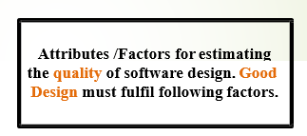
Goals of a Software Design
Designers faces many challenges to produce a good product, e.g. shifting requirements.
But what do we mean by good?
We need some clear goals here …
Good design leads to software that exhibits:
Correctness
Robustness
Flexibility
Reusability
Efficiency
Reliability
Usability

Slide 10
Software Design Goals : Correctness
Software is correct, if it satisfies its requirements.
The more specific a question, the more precisely we can verify the correctness of a design that answers it
Precise and imprecise questions:
What number adds to 3 to get 5? (precise)
What bridge design gets cars from point A to point B? (imprecise)
Correctness of design usually means sufficient design

Slide 11
Approaches to Correctness
How can we know that a design is correct or even sufficient?
Informal Approaches
To be convinced that the design covers the required functionality. (Sufficient Design)
Formal Approaches
Involve applying logic to analyzing the way in which the variables change
Usually applied when the design enters the detailed stage
(Testing, Inspection etc)

Slide 12
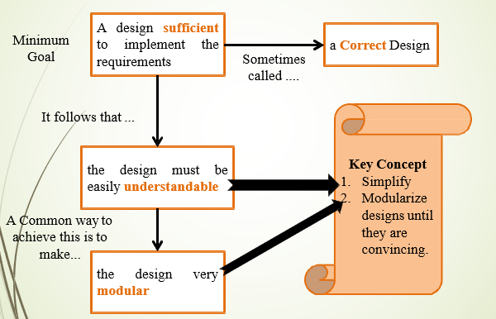
Informal Approach: Sufficient Design

Slide 13
Software Design Goals: Robustness
Robustness --- ability to handle anomalous situations even in the presence of errors (Fault tolerant)
Sources of error ???
Faulty input
User input
Inputs not from Users (Function Parameters etc)
Developer errors
Faulty design
Faulty implementation

Slide 14
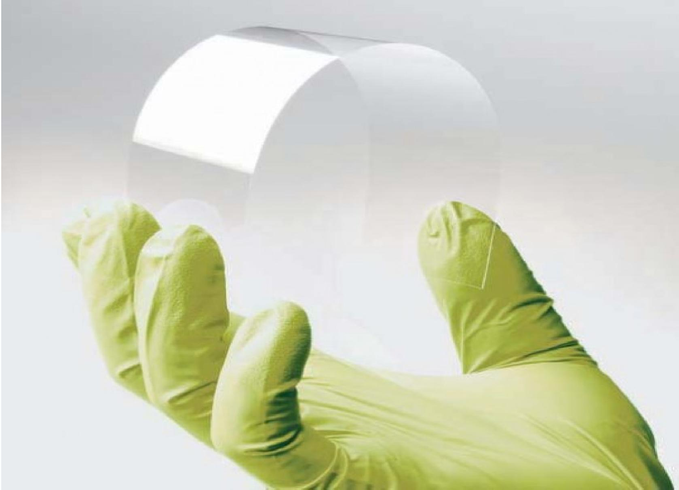
Software Design Goals: Flexibility
Flexible design implies a design that can easily accommodate the changes
Aspects of Flexibility 1. Adding more of the same kind of functionality
Example (banking application): handle more kinds of accounts without having
to change the existing design or code.
2. Adding different functionality
Example: add withdraw function to existing deposit functionality to user
3. Changing functionality

Slide 15
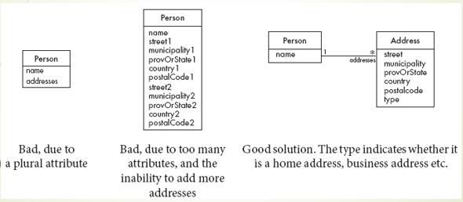
Flexibility: Designs for Adding More of the Same Kind of Functionality

Slide 16

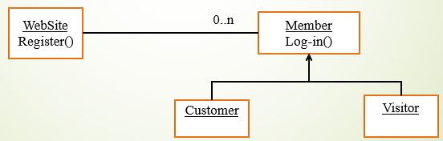
Flexibility: Design for Adding Different Functionality
Case 1: Handled by adding the new method to an existing set of methods of a class
Case 2: adding functionality through a base class

Slide 17
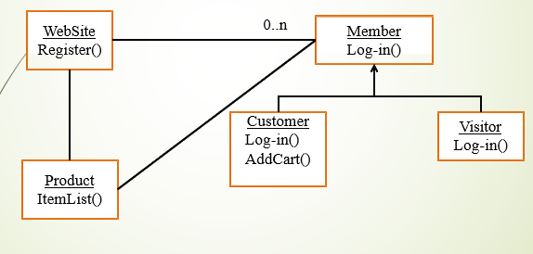
Flexibility: Changing Functionality
Flexible enough to accommodate functionality changing

Slide 18

Reusability
Designing a software system such that components of a developed system can be used again in developing new applications
Reusability is an important factor in producing low cost applications.

Slide 19
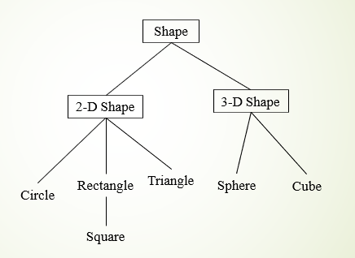
Reusability: Promoting Source Code Reuse
Use modularity

Slide 20

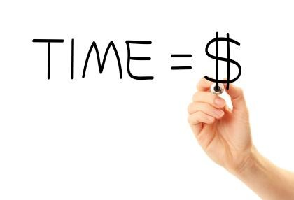
Efficiency
Applications must execute required functionality within required time constraints.
Two dimensions of efficiency:
Time
Space

Slide 21
Reliability
Reliability– mean time to failure (system crash, error)
On architectural level can use hardware support, backup servers, multiple processors, etc
On code level achieved by software quality assurance methods, testing, walkthroughs, formal methods etc.

Slide 22
Usability
Users must find software easy to easy.
Intuitive GUI, standard layout & meanings
Good documentation,
Hard to define and measure, user interviews, questionnaires, etc.

Slide 23
Conceptual Design
Definition: Conceptual design refers to the early stages of the design process, where
the focus is on defining the structure, functionality, and user experience before delving into
technical details.
Purpose: Helps visualize and communicate the system design to stakeholders, developers,
and users.
Conceptual Design Includes:
Wireframes
Mockups
Prototypes

Slide 24
What is Wireframe?
wireframe is a low-fidelity representation of a system’s interface, focusing on the layout and navigation without detailed styling.
Purpose: Helps plan the structure and functionality of the user interface, including the placement of elements like buttons, menus, and content areas.
When to Use: During the initial planning phase to brainstorm the design layout.
Tools Used:
Balsamiq, Figma, Axure

Slide 25
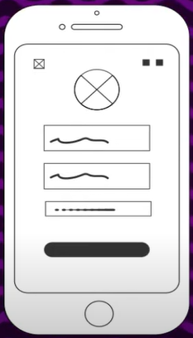
Example: Mobile App Wireframe
image is Displaying a wireframe of a mobile app screen with basic layout elements like buttons and placeholders for content.

Slide 26
What is Mockup?
A mockup is a static, high-fidelity design of a system's user interface that showcases the look and feel of the final product.
Purpose: Focuses on aesthetics like color schemes, fonts, and spacing but doesn’t include functionality.
When to Use: After wireframing, to gain approval on the visual design before actual development.
Tools Used:
Adobe XD
Figma
Sketch

Slide 27
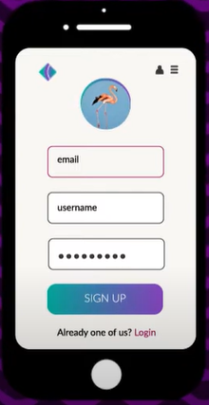
Example: Mobile app Mockup:
Image: Include an image of a mobile application mockup (e.g., a static signup page showing color, typography, and layout).

Slide 28
What is Prototype?
A prototype is an early, simplified version of a software application designed to test concepts, design, and functionality before full development.
Purpose:
To visualize how the final system will work.
Allows for feedback from stakeholders early in the development process.
When to Use Prototyping
Unclear Requirements
User Interface (UI) Design
Complex Systems
Types of Prototypes
1. Throwaway/Rapid Prototyping:
Built quickly and discarded after use.
Focuses on exploring ideas or testing specific features.
2. Evolutionary Prototyping:
Developed iteratively and refined into the final system.
Used when requirements are unclear or evolving.

Slide 29
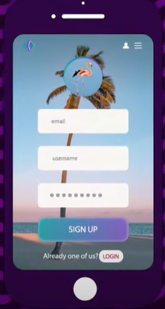
Example: Mobile App Prototype

Slide 30
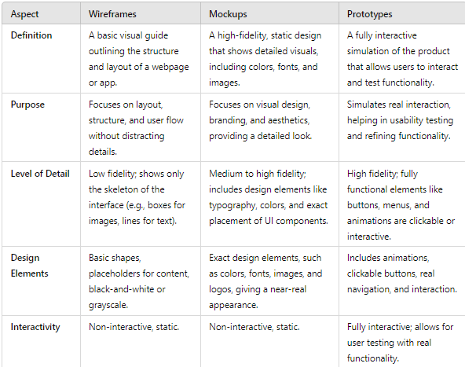
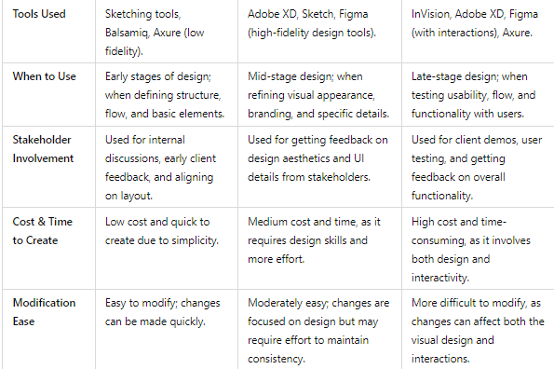
Comparison: Wireframes vs Mockups vs Prototypes

Slide 31
https://www.youtube.com/watch?v=_SCcl06wZZs

